Slide 1
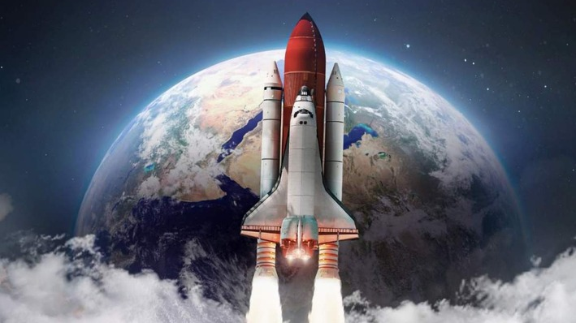
NASA Space Mission AI Project

Slide 2
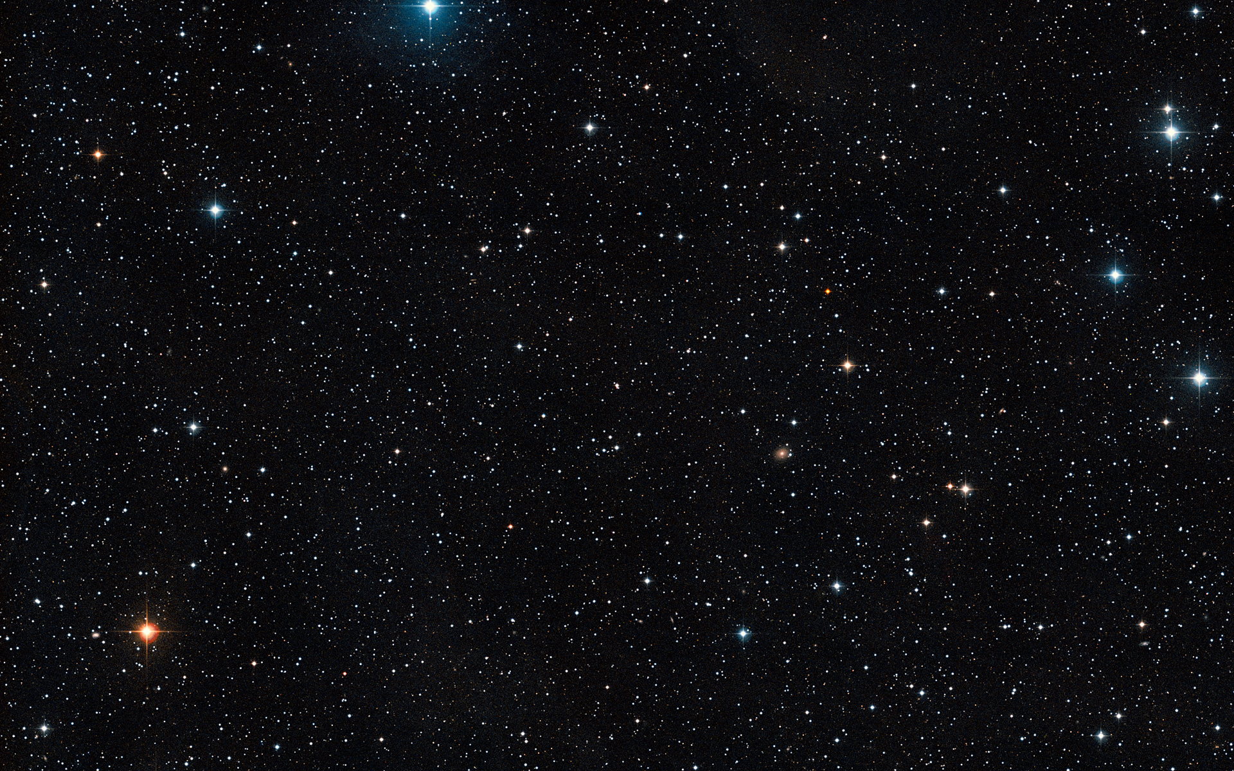
Track: Implementation Track
Project Description: Build an AI to predict radiation exposure levels for astronauts based on numerical data from space weather (e.g., solar activity, cosmic ray flux).
Dataset: Use NASA’s space weather datasets.
Models:
Use Neural Network
Use regression models (e.g., Linear Regression, XGBoost) to predict radiation levels from input variables like solar flare intensity.

Slide 3
Features (inputs):
Solar wind speed (VxGSE) — speed of charged particles flowing from the Sun
Proton density (Np) — concentration of solar protons in the solar wind
IMF components (BxGSE, ByGSE, BzGSE) — interplanetary magnetic field vector components
Solar radio flux (F10) — 10.7 cm solar radio emission, a proxy for solar activity
Geomagnetic index (kp_3h) — geomagnetic disturbances over 3-hour intervals
Proton flux (proton_flux_10MeV) — high-energy solar protons measured by GOES satellites
Target (output):
Radiation dose (radiation_dose_mSv) — a synthetic value representing astronaut radiation exposure in millisieverts, generated as a weighted sum of input features plus noise

Slide 4
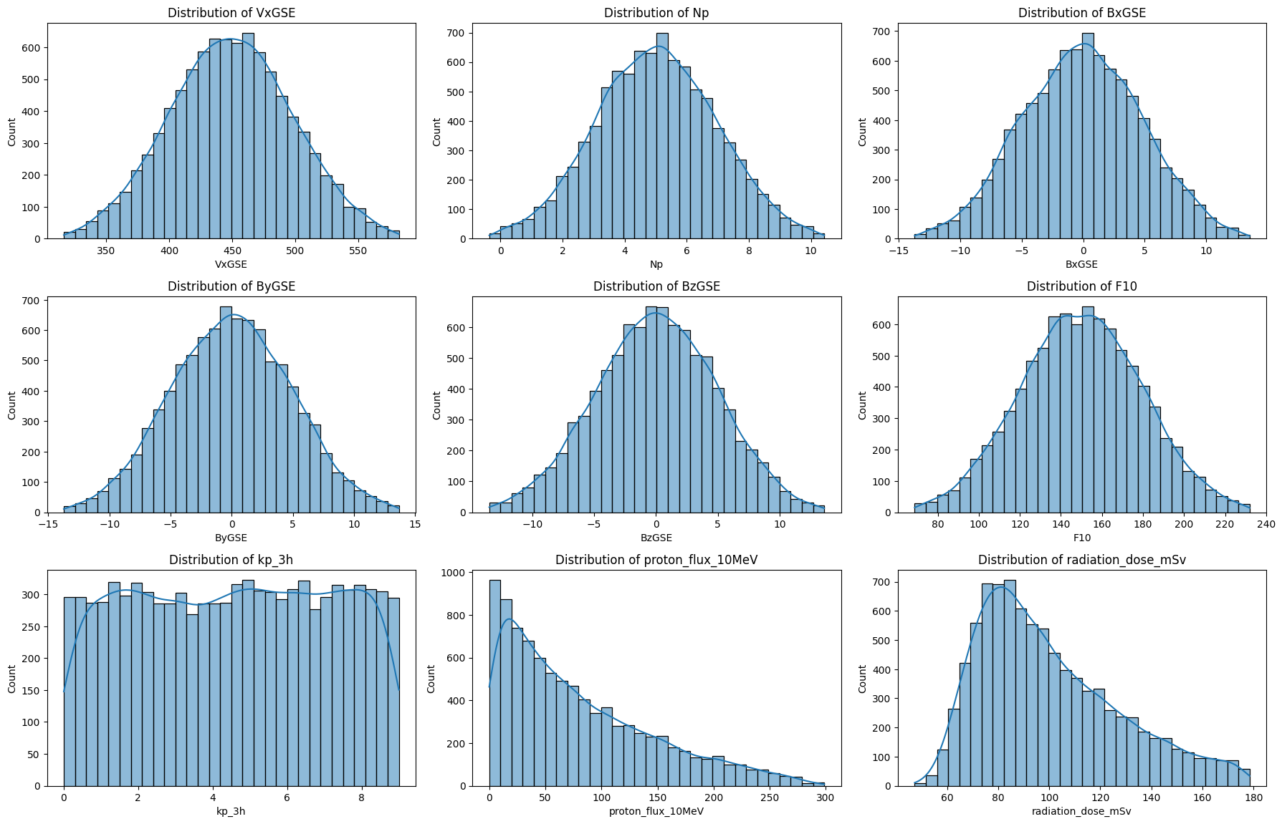
Data Distributions

Slide 5
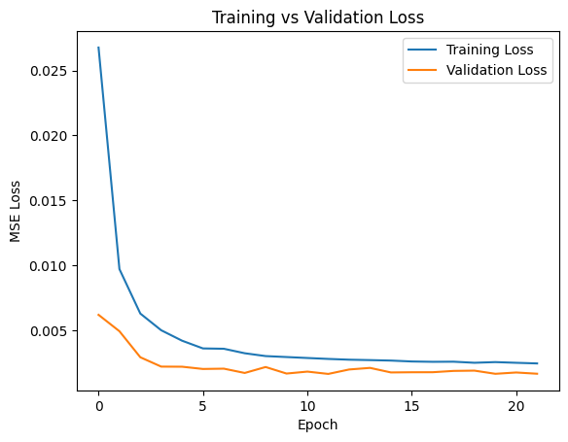
Neural Network
Training VS Loss Validaton
ReLu Activation
Loss Function: Adam Optimizer
Sequential Model
2 Layers
Evaluation
MSE: 0.00
R^2: 0.9623

Slide 6
Regression Models
Linear Regression:
MSE = 0.00, R2 = 0.9649
Ridge Regression:
MSE = 0.00, R2 = 0.9650
Lasso Regression:
MSE = 0.04, R2 = -0.0000
Random Forest:
MSE = 0.00, R2 = 0.9616
Bayesian Ridge: MSE = 0.00, R2 = 0.9649
XGBoost:
MSE = 0.00, R2 = 0.9592

Slide 7
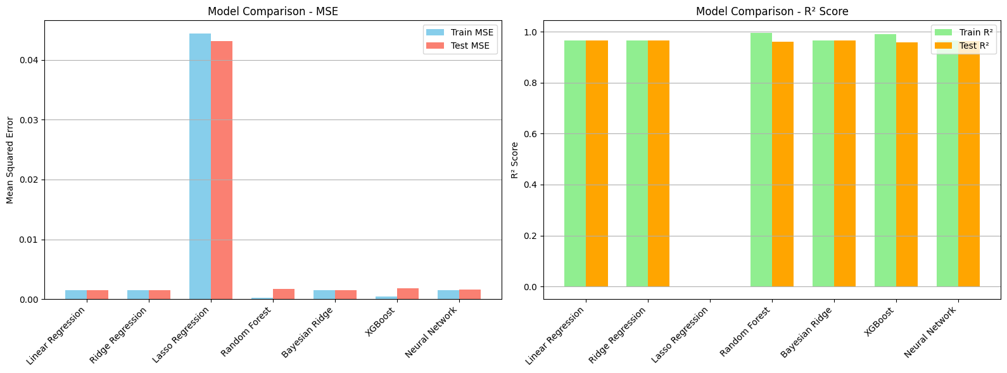
Comparisons

Slide 8
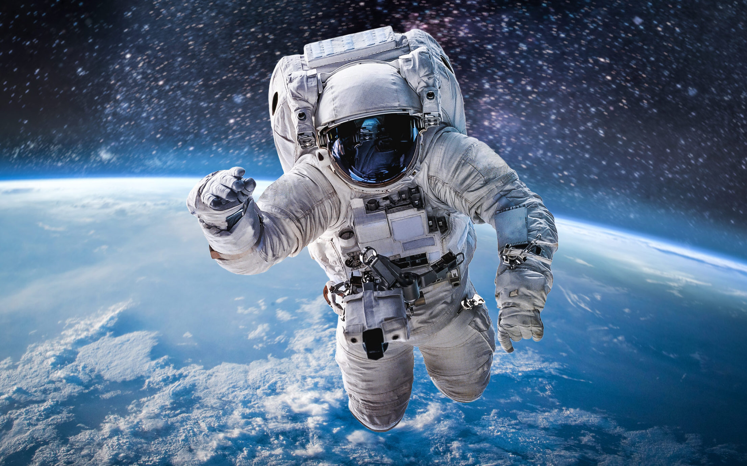
Thank You

